Slide 1
14 Aug 18
Notes:
Introduction, this is me, will be talking about predicting game outcomes from what the agent is experiencing while playing.

Slide 5
General Video Game AI Framework & Competition: gvgai.net
Notes:
1 alg -> 10.000 instances played, 15 million game ticks

Slide 7
Notes:
14 alg -> 140.000 instances played, 210 million game ticks

Slide 8
<
>
*
*
<
>
*
>
<
>
*
<
<
*
<
>
*
<
*

Slide 9
>
>
>
<
<
<
*
*
*
*
*
*
<
<
<
<
<
<
<
>
>
>
>
>
*
*
*
>
>
>
>
>
>
>
>
>
>
<
<
<
*
*
*
<
<
<
<
<
*
<
<
<
>
>
<
*
*
>
>
>
*
*
*
*
<
<
<
<
<
<
>
<
<
*
*
*
<
<
<
*
*
*
*
*
*
>
>
>
<
<
<
>
>
>
<
<
<
*
*
*
*
*
*
<
<
<
<
<
<
<
>
>
>
>
>
*
*
*
>
>
>
>
>
>
>
>
>
<
<
<
*
*
*
<
<
<
*
<
<
<
<
<
<
>
>
>
*
*
*
>
>
*
*
<
<
<
<
>
<
*
*
<
<
*
*
*
*
>
>
<
*
<
<
<
*
<
*
*
>
<
<

Slide 10
>
<
*
*
<
<
>
>
*
>
>
>
<
*
<
<
<
>
*
>
*
*
<
<
<
*
<
*
*
>
<
>
<
*
*
<
<
>
>
*
>
>
>
<
*
<
<
<
>
*
>
*
<
<
<
*
<
*
*
>
<
*
*
<
>
<
>
*
*
>
>
<
<
*
>
<
>
<
>
>
>

Slide 13
f₁
f

Slide 15
¹ http://scikit-learn.org
² Y. Freund, R. Schapire, “A Decision-Theoretic Generalization of on-Line Learning and an Application to Boosting”, 1995.
³ J. Zhu, H. Zou, S. Rosset, T. Hastie, “Multi-class AdaBoost”, 2009.
Notes:
that begins by fitting a classifier on the original dataset and then fits additional copies of the classifier on the same dataset but where the weights of incorrectly classified instances are adjusted such that subsequent classifiers focus more on difficult cases.
The base estimator from which the boosted ensemble is built. Support for sample weighting is required, as well as proper classes_ and n_classes_ attributes.
The maximum number of estimators at which boosting is terminated. In case of perfect fit, the learning procedure is stopped early.
Learning rate shrinks the contribution of each classifier by learning_rate. There is a trade-off between learning_rate and n_estimators.
If ‘SAMME.R’ then use the SAMME.R real boosting algorithm. base_estimator must support calculation of class probabilities. If ‘SAMME’ then use the SAMME discrete boosting algorithm. The SAMME.R algorithm typically converges faster than SAMME, achieving a lower test error with fewer boosting iterations.
If int, random_state is the seed used by the random number generator; If RandomState instance, random_state is the random number generator; If None, the random number generator is the RandomState instance used by np.random.

Slide 20
Early game, 0-30%
Late game, 0-30%

Slide 22
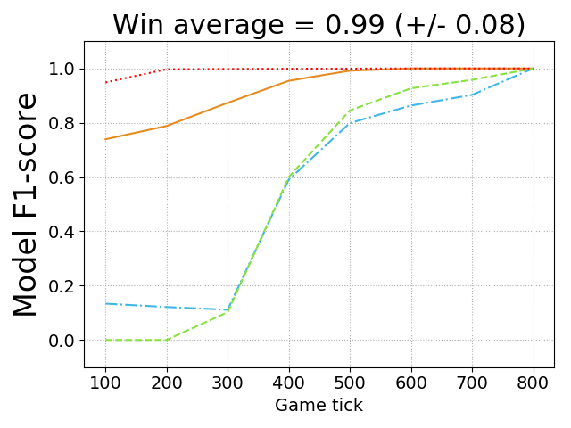
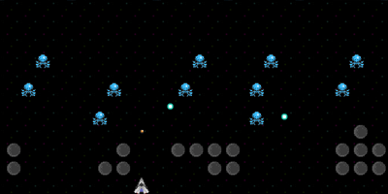

Slide 23
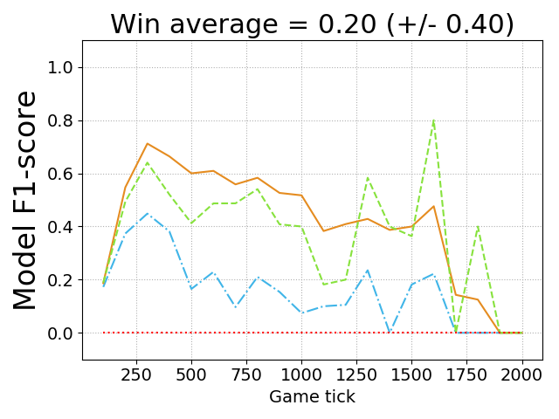
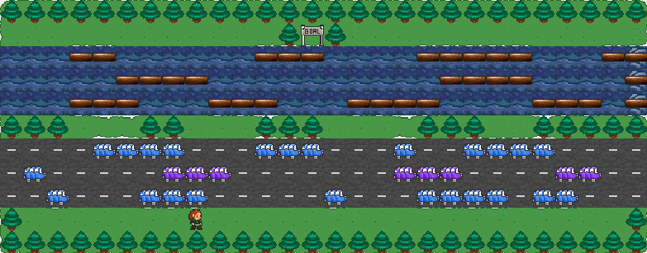

Slide 24
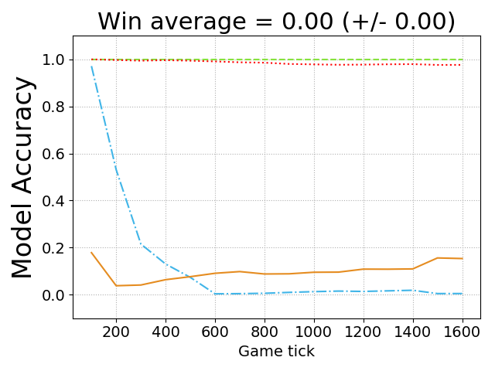
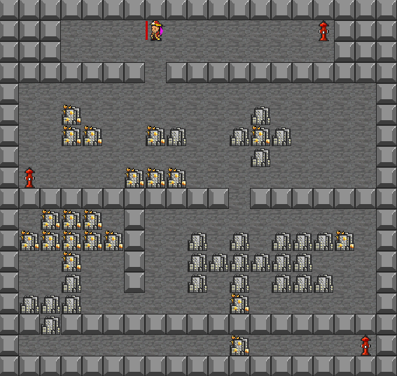

Slide 25
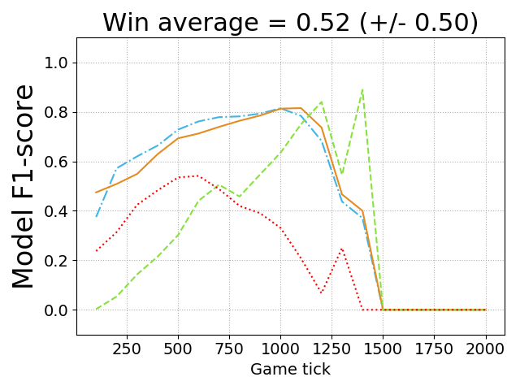

Slide 27
¹ LIME system, https://github.com/marcotcr/lime

Slide 29
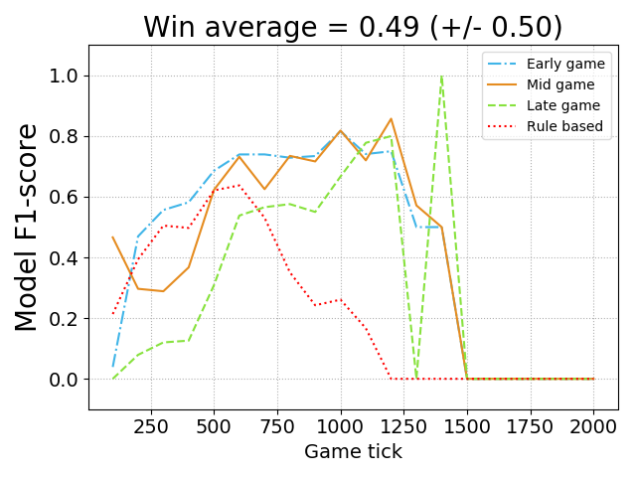
RHEA + RS + MCTS (train + test)
RHEA + RS (train), MCTS (test)

Slide 31
youtu.be/zq9zaEjspUY

Slide 32
Live play + FM
Game N
Game 2
Game 1
t = 55
t = 56
t = 57
t = 58

Slide 36
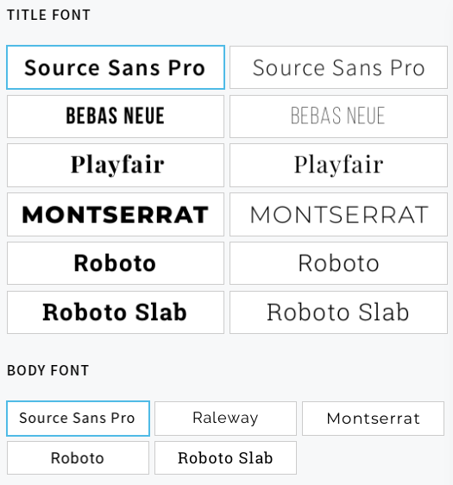
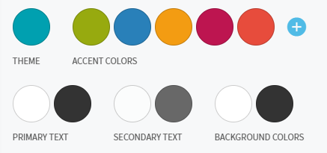
Text

